Slide 1

Welcome
A Presentation on
Attendance Monitoring System by Face Recognition using Deep Learning Technology and Computer Vision
Semester: Spring 2021-22

Slide 2
Supervised by
Dr. Debojyoti Karmaker
Assistant Professor
Department of Computer Science
American International University-Bangladesh
Group Members
IHSAN MD. AL AQIB 18-37074-1
MD. SAKIBUL ALAM UTCHAS 18-37079-1
S.M. IRAMUL MURSHED 18-37069-1
HASEBUL HASAN SHIHAB 18-37031-1

Slide 3
Agenda
introduction
related works
cnn layers
model
result
limitations
future work
The background of the study
Theoretical aspects of our study
Discussing the different layers of cnn
Discussing the model of the study
Discussing the findings of the study
Limitations of the model
future scope

Slide 4

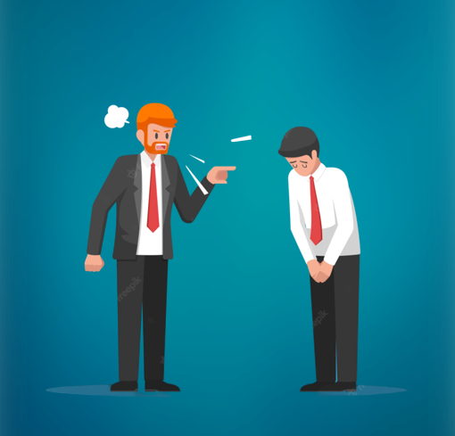

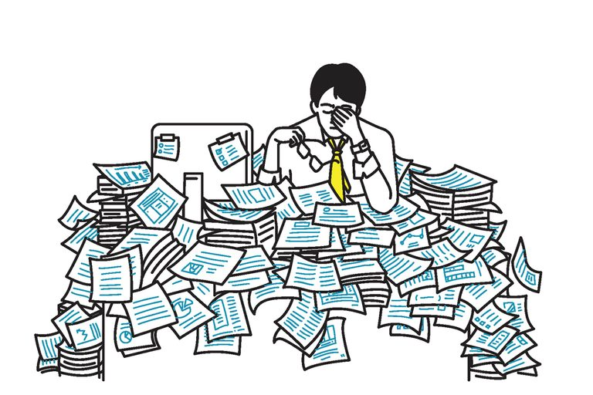
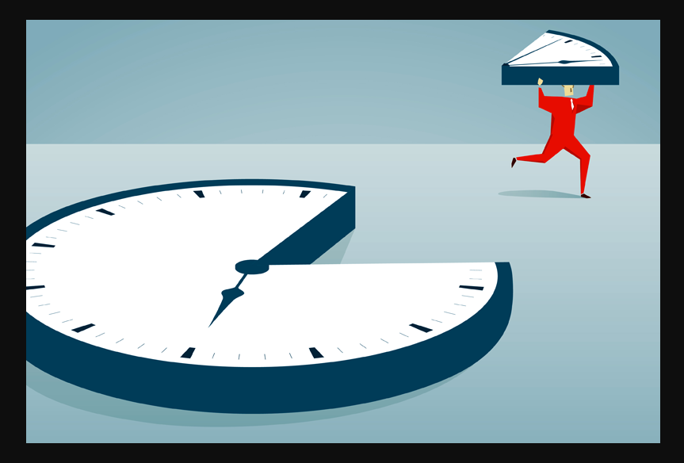

related work
model
introduction
future work
limitations
result
cnn layers

Slide 5
related work
model
introduction
future work
limitations
result
cnn layers
Group Members
MD. MUZAKKER HOSSAIN 18-37801-2
ZAHIN AWOSAF 18-37064-1
MD. SALMAN HOSSAN PROTTOY 18-36902-1
ABU SALEH MUHAMMOD ALVY 18-37487-1

Slide 6
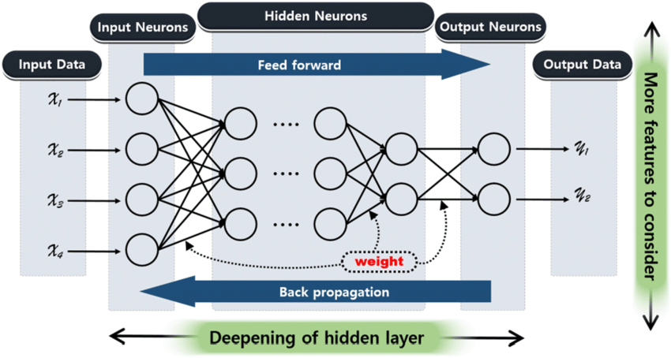
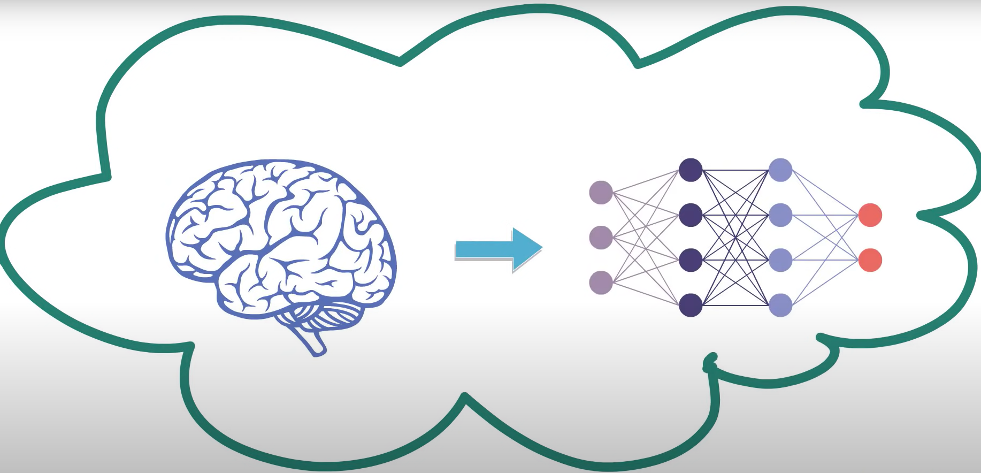
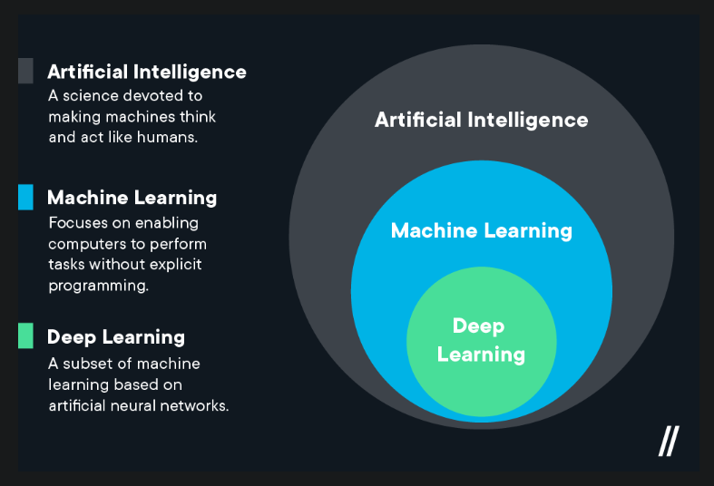
related work
model
introduction
future work
limitations
result
cnn layers

Slide 7
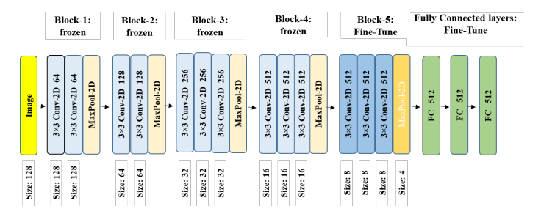
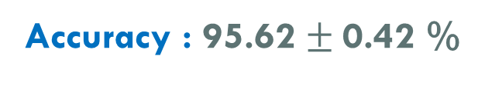
Using Siamese Networks with Transfer Learning for Face Recognition on Small-Samples Datasets
Model : Siamese-VGG
Dataset Used : LFW dataset
model
Contains over 13000 facial images of 1680 individuals.
Coloured images with image size 250 X 250.
related work
future work
introduction
limitations
result
cnn layers
Group Members
MD. MUZAKKER HOSSAIN 18-37801-2
ZAHIN AWOSAF 18-37064-1
MD. SALMAN HOSSAN PROTTOY 18-36902-1
ABU SALEH MUHAMMOD ALVY 18-37487-1
Accuracy : 95.62 $±$0.42 %
Fig. : VGG-16 with fully connected layers on top for fine-tuning.

Slide 8
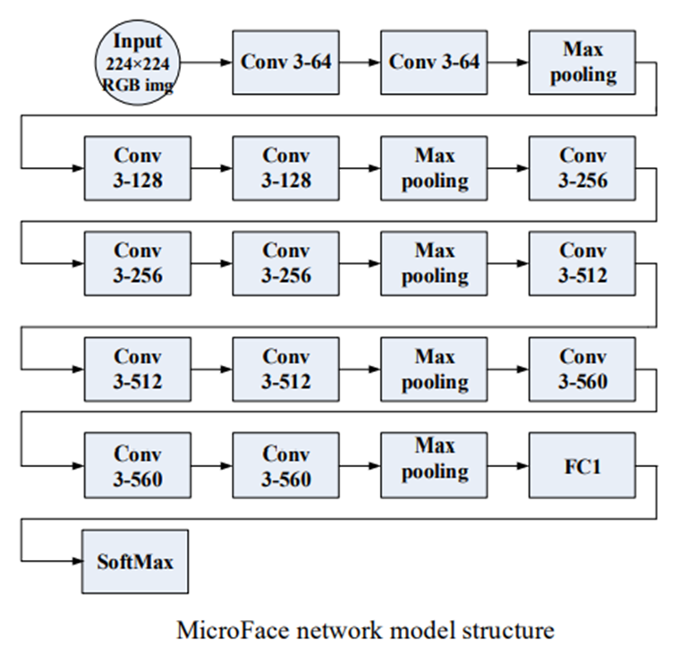
Face recognition based on improved VGGNET convolutional neural network
Model : MicroFace (VGG-16 Based)
Dataset Used : CASIA WebFace
model
related work
future work
introduction
limitations
result
cnn layers
Contains 500000 images of 10575 people.
Coloured images with image size 224 X 224.
Group Members
MD. MUZAKKER HOSSAIN 18-37801-2
ZAHIN AWOSAF 18-37064-1
MD. SALMAN HOSSAN PROTTOY 18-36902-1
ABU SALEH MUHAMMOD ALVY 18-37487-1
Accuracy : 96.26%

Slide 9
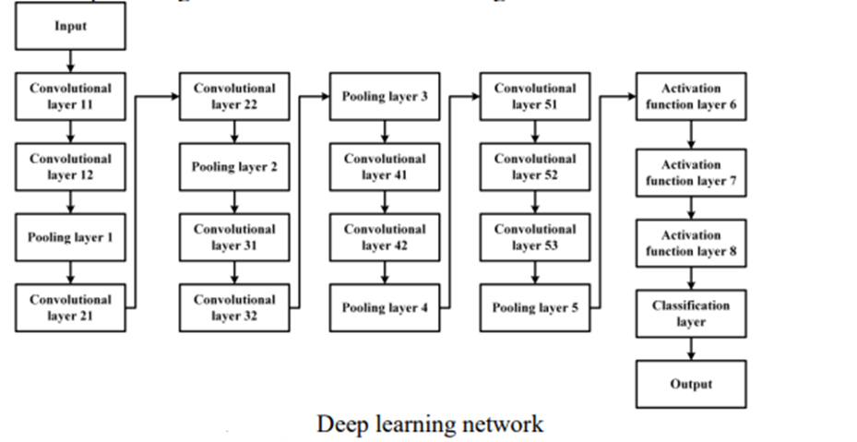
Face Recognition Algorithm Based On Convolutional Neural Network
Model : CNN
model
Dataset Used : CASIA WebFace
related work
future work
introduction
limitations
result
cnn layers
Group Members
MD. MUZAKKER HOSSAIN 18-37801-2
ZAHIN AWOSAF 18-37064-1
MD. SALMAN HOSSAN PROTTOY 18-36902-1
ABU SALEH MUHAMMOD ALVY 18-37487-1
Contains 494414 images of 10575 people.
100×100×1 grayscale image.
Accuracy : 98.78%

Slide 10
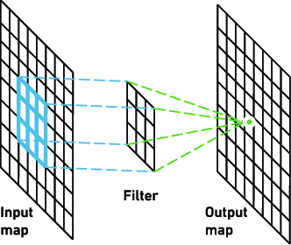
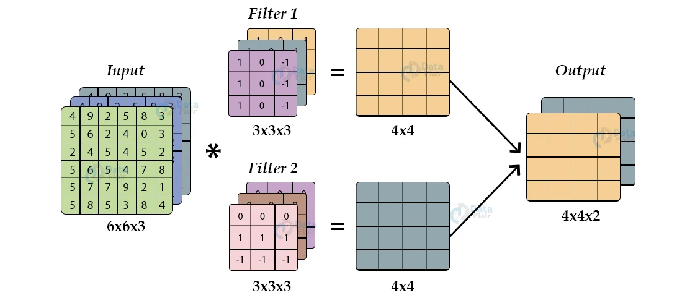
Convolutional layer
model
related work
future work
introduction
limitations
cnn layers
result
Group Members
MD. MUZAKKER HOSSAIN 18-37801-2
ZAHIN AWOSAF 18-37064-1
MD. SALMAN HOSSAN PROTTOY 18-36902-1
ABU SALEH MUHAMMOD ALVY 18-37487-1
Example of Convolutional layer

Slide 11
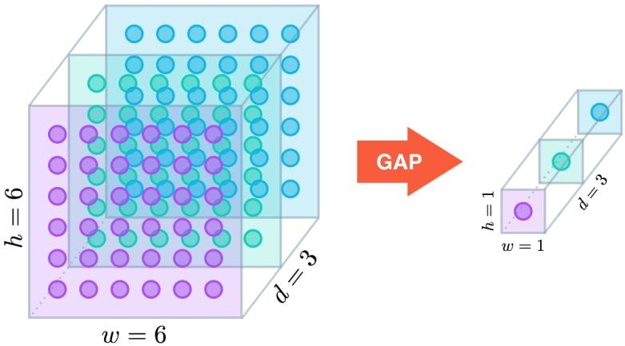
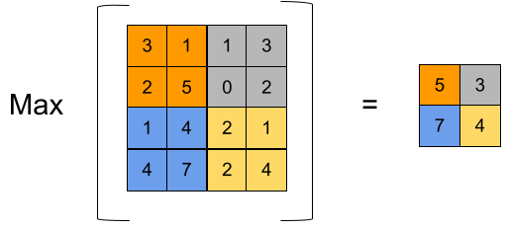
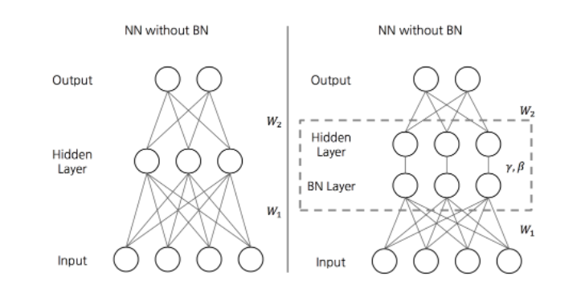
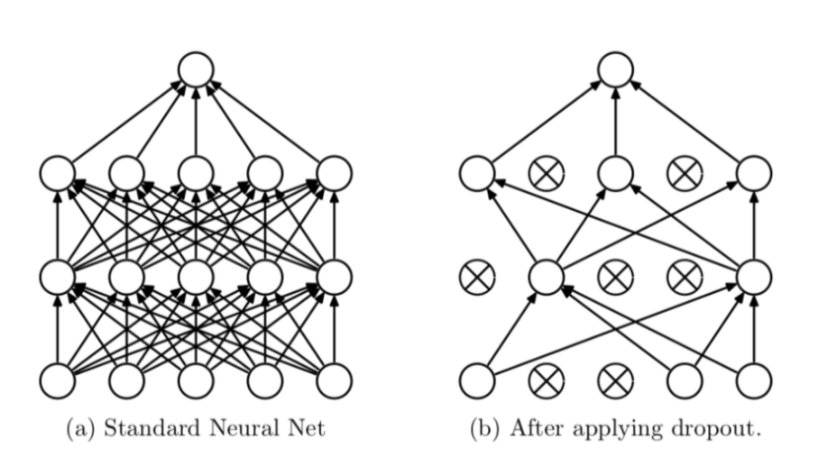
Global Average Pooling
Max Pooling
model
related work
future work
introduction
limitations
cnn layers
result
Group Members
MD. MUZAKKER HOSSAIN 18-37801-2
ZAHIN AWOSAF 18-37064-1
MD. SALMAN HOSSAN PROTTOY 18-36902-1
ABU SALEH MUHAMMOD ALVY 18-37487-1
Batch normalization
Dropout

Slide 12
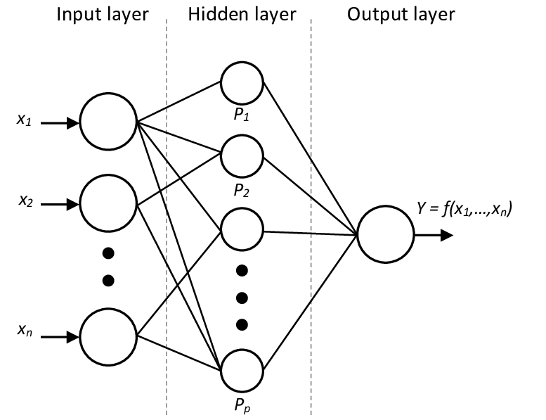
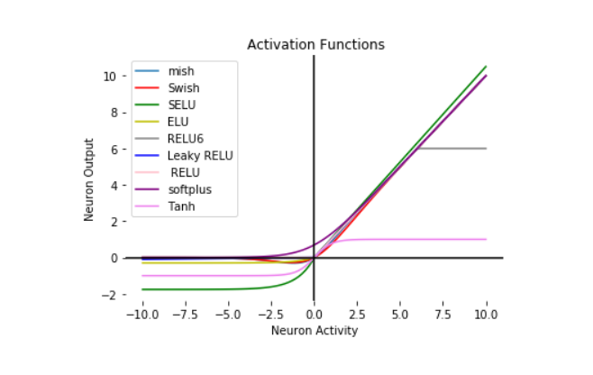
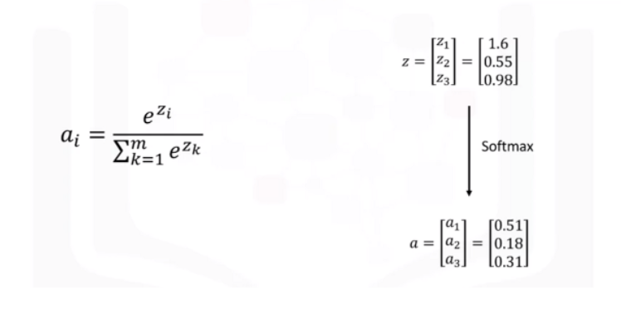
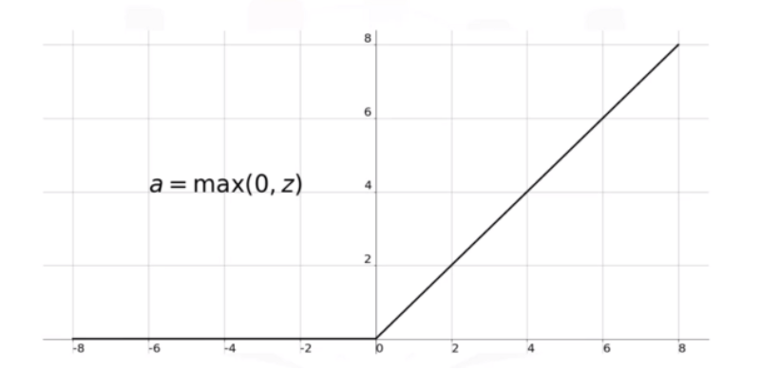
Dense Layer
Activation functions
model
related work
future work
introduction
limitations
cnn layers
result
Group Members
MD. MUZAKKER HOSSAIN 18-37801-2
ZAHIN AWOSAF 18-37064-1
MD. SALMAN HOSSAN PROTTOY 18-36902-1
ABU SALEH MUHAMMOD ALVY 18-37487-1
Softmax Function
ReLU Function

Slide 13
INPUT
CONV1_1
224X224X64
CONV1_2
224X224X64
MAXPOOL
224X224X3
MAXPOOL
112X112X64
CONV2_1
112X112X128
CONV2_2
112X112X128
56X56X128
CONV3_1
56X56X256
CONV3_2
56X56X256
CONV3_3
56X56X256
MAXPOOL
28X28X256
CONV4_1
28X28X512
CONV4_2
28X28X512
CONV4_3
28X28X512
MAXPOOL
14X14X512
CONV5_1
14X14X512
CONV5_2
14X14X512
CONV5_3
14X14X512
MAXPOOL
7X7X512
FC ReLU
1X1X4096
FC ReLU
1X1X4096
FC ReLU
1X1X1000
FC SOFTMAX (OUTPUT)
1X1X1000
related work
model
future work
introduction
limitations
result
cnn layers
Group Members
MD. MUZAKKER HOSSAIN 18-37801-2
ZAHIN AWOSAF 18-37064-1
MD. SALMAN HOSSAN PROTTOY 18-36902-1
ABU SALEH MUHAMMOD ALVY 18-37487-1
VGG16 ARCHITECTURE
Notes:
Thank you Hasebul hasan shihab. Hello everyone, I’m Ihsan Md. Al-Aqib. Here I’m going to present vgg16 ARCHITECTURE.
The number 16 in the name VGG refers to the fact that it is 16 layers deep neural network. This means VGG16 is a pretty extensive network and has a total of around 138 million parameters. VGG-16 configuration consists of 13 convolution network layers and 3 fully connected layers and stacked sequentially in 2 or 3 convolution network layers to build a module. Each module is followed by a maximum pool. It has three fully connected layers at the end of the structure, and the SoftMax layer outputs the identification class.
You can load a pretrained version of the network trained on more than a million images from the ImageNet database. The pretrained network can classify images into different categories.

Slide 14
INPUT
CONV1_1
224X224X64
CONV1_2
224X224X64
MAXPOOL
224X224X3
MAXPOOL
112X112X64
CONV2_1
112X112X128
CONV2_2
112X112X128
56X56X128
CONV3_1
56X56X256
CONV3_2
56X56X256
CONV3_3
56X56X256
MAXPOOL
28X28X256
CONV4_1
28X28X512
CONV4_2
28X28X512
CONV4_3
28X28X512
MAXPOOL
14X14X512
CONV5_1
14X14X512
CONV5_2
14X14X512
CONV5_3
14X14X512
MAXPOOL
7X7X512
related work
model
future work
introduction
limitations
result
cnn layers
Group Members
MD. MUZAKKER HOSSAIN 18-37801-2
ZAHIN AWOSAF 18-37064-1
MD. SALMAN HOSSAN PROTTOY 18-36902-1
ABU SALEH MUHAMMOD ALVY 18-37487-1
VGG16 REMOVED FC LAYERS
Notes:
Here removing layers from vgg16. Fully connected layers of vgg16 has been removed.

Slide 15
DENSE ReLU
DROPOUT
DENSE_1 ReLU
NORM_1
512
512
NORM
512
512
256
256
DROPOUT_1
256
DENSE_2 ReLU
128
NORM_2
128
DROPOUT_2
128
SOFTMAX (OUTPUT)
43
GLOBAL AVGPOOL
INPUT
7X7X512
related work
model
future work
introduction
limitations
result
cnn layers
Group Members
MD. MUZAKKER HOSSAIN 18-37801-2
ZAHIN AWOSAF 18-37064-1
MD. SALMAN HOSSAN PROTTOY 18-36902-1
ABU SALEH MUHAMMOD ALVY 18-37487-1
DENSE LAYERS
Notes:
Here is our model, takes input 7X7 and 512 input channel shape then input goes to global avgpool after that the matrices pass through 3 times to dense layer which activate ReLU activation, normalization and dropout layer with different input channel. Finally, it comes to output layer and activate softmax activation.

Slide 16
DENSE ReLU
DROPOUT
DENSE_1 ReLU
NORM_1
512
512
NORM
512
512
256
256
DROPOUT_1
256
DENSE_2 ReLU
128
NORM_2
128
DROPOUT_2
128
SOFTMAX (OUTPUT)
43
GLOBAL AVGPOOL
INPUT
224X224X3
CONV1_1
224X224X64
CONV1_2
224X224X64
MAXPOOL
112X112X64
CONV2_1
112X112X128
CONV2_2
112X112X128
MAXPOOL
56X56X128
CONV3_1
56X56X256
CONV3_2
56X56X256
CONV3_3
56X56X256
MAXPOOL
28X28X256
CONV4_1
28X28X512
CONV4_2
28X28X512
CONV4_3
28X28X512
MAXPOOL
14X14X512
CONV5_1
14X14X512
CONV5_2
14X14X512
CONV5_3
14X14X512
MAXPOOL
7X7X512
related work
model
future work
introduction
limitations
result
cnn layers
Group Members
MD. MUZAKKER HOSSAIN 18-37801-2
ZAHIN AWOSAF 18-37064-1
MD. SALMAN HOSSAN PROTTOY 18-36902-1
ABU SALEH MUHAMMOD ALVY 18-37487-1
MODEL PREPARED
Notes:
Here concatenated our model with vgg16 pretrained model. Now you can see the shape of the joining point matched. That means there won’t be any error on joining.

Slide 17
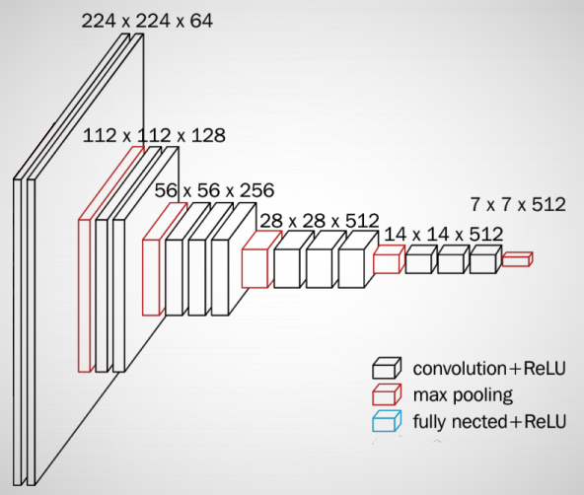
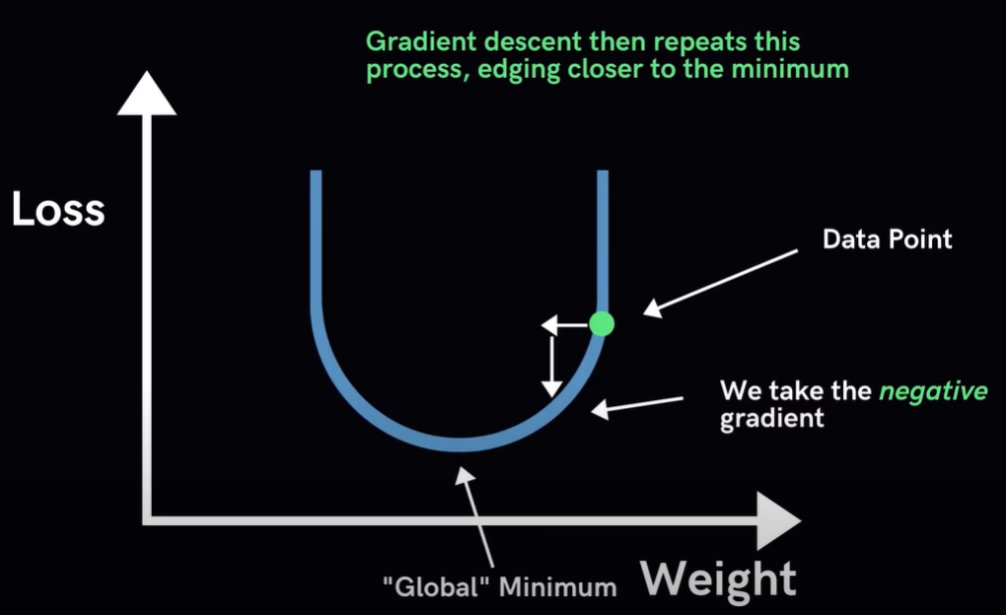
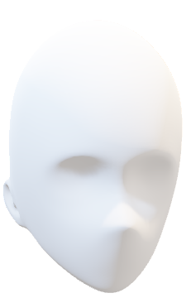
new_lr = lr * factor
VGG16 PRETRAINED
224x224x3
VGG16 pretrained model on ImageNet
Removed dense layer from vgg16
Combined model
INPUT
ImageNET
AVERAGE POOL
DENSE
BATCH NORMALIZATION
DROPOUT
DENSE
BATCH NORMALIZATION
DROPOUT
DENSE
BATCH NORMALIZATION
DROPOUT
OUTPUT
Frozen
related work
future work
introduction
limitations
model
result
cnn layers
Group Members
MD. MUZAKKER HOSSAIN 18-37801-2
ZAHIN AWOSAF 18-37064-1
MD. SALMAN HOSSAN PROTTOY 18-36902-1
ABU SALEH MUHAMMOD ALVY 18-37487-1
Factor 0.2
Learning rate= 1e-3
new_lr = lr * factor
Notes:
Here you can see it takes input first from the dataset and go through the vgg16 which already has trained value from imageNET database. After that the matrices value Loop through our model.
In this combined model we use transfer learning which learning rate starts at 1e-3, reduce learning rate by o.2 factor is specialty of this model. In that case vgg16 value has been frozen or not upgrading weights value, only upgrading value on loop area.
Now, Transfer learning
Iterative Algorithm that starts off at a random point on the loss function and travels down its slope in steps until it reaches the lowest point (minimum) of the function.
Algorithm works by (i)Calculate what a small change in each individual weight would do to the value loss function and (ii)Adjust each parameter based on its take a small step in the determined direction. Repeat steps until the value loss function is as low as possible.
Reduce learning function monitor the value loss and factor by which the learning rate will be reduced. click
This function also has a parameter called patience which count number of epochs with no improvement after which learning rate will be reduced. Another parameter called min_lr which is a lower bound on the learning rate.
Now my fellow teammate MD SAKIBUL ALAM UTCHAS will continue

Slide 18
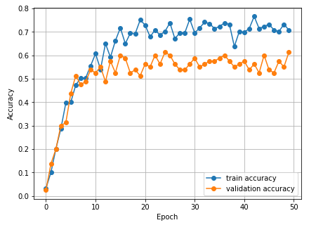
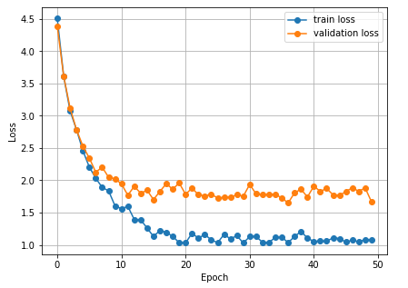
DATASET: 430 images belonging to 43 classes
Training: 344 images belonging to 43 classes.
Validation : 0.2% (86 images belonging to 43 classes)
ACCURACY: 61.125%
related work
model
future work
introduction
limitations
result
cnn layers
Group Members
MD. MUZAKKER HOSSAIN 18-37801-2
ZAHIN AWOSAF 18-37064-1
MD. SALMAN HOSSAN PROTTOY 18-36902-1
ABU SALEH MUHAMMOD ALVY 18-37487-1
Notes:
Thanks Aqib. Assalamu Alaikum. I am MD SAKIBUL ALAM UTCHAS.
Now the question is how the model was trained and what the result was?
As we can see from the slide, to train the model, we created a custom dataset that contains 430 images of 43 people, and from that dataset, 0.8% images used for training and 0.2% images were used for validation. The model was trained up to 50 EPOC. we can see from the graph after training that the validation accuracy was increasing gradually and the validation loss was decreasing. After the training, we got over 61% accuracy, which is a modest result because this is a fine-grained classification.

Slide 19
The accuracy is modest, despite the use of fine-grained classification.
It is necessary to ensure that the face is visible.
Small dataset
related work
model
future work
limitations
introduction
result
cnn layers
Group Members
MD. MUZAKKER HOSSAIN 18-37801-2
ZAHIN AWOSAF 18-37064-1
MD. SALMAN HOSSAN PROTTOY 18-36902-1
ABU SALEH MUHAMMOD ALVY 18-37487-1
Notes:
There are also some limitations to our project. To ensure face recognition works perfectly, it is necessary to ensure that the face is visible perfectly. Otherwise, the system fails to recognize the face. Another problem is that, since we are doing fine-grained classification, so all the features extracted from the picture are almost the same, and because of that, it is hard to identify the person. On the other hand, the accuracy will be much higher if we classify different species like cats, dogs, rats, etc. Also, the dataset we used was relatively small. So, by using large datasets, the overall accuracy can be increased.

Slide 20
Future Work
Detect and recognize face from real time video feed.
Check for eye blinks
Use large dataset for higher accuracy
related work
model
future work
introduction
limitations
result
cnn layers
Group Members
MD. MUZAKKER HOSSAIN 18-37801-2
ZAHIN AWOSAF 18-37064-1
MD. SALMAN HOSSAN PROTTOY 18-36902-1
ABU SALEH MUHAMMOD ALVY 18-37487-1
Notes:
We need to take attendance most of the places, and the system of taking attendance is manual, which consumes valuable time and effort. Our goal is to automate the attendance system using computer vision and deep learning using state-of-the-art technology. To make our system better in the future, we will work on a module which can recognize face from real-time video feed and also check for eye bilks to identify real human presence. It’s an added layer of security to prevent any attendance by showing a picture of a person. Science this a fine-grained classification, to improve the accuracy of the model we will work on larger dataset with more sample images of the same class to improve accuracy so that the system can be used more reliably. If we can build and use a system like that, then we can avoid the hassle of taking attendance and use this time for other important work. The system can also be used for identifying unauthorized people. For all those reasons, future research needs to be done in this field.

Slide 21
Thank You
related work
model
future work
introduction
THE END
limitations
result
cnn layers
Group Members
MD. MUZAKKER HOSSAIN 18-37801-2
ZAHIN AWOSAF 18-37064-1
MD. SALMAN HOSSAN PROTTOY 18-36902-1
ABU SALEH MUHAMMOD ALVY 18-37487-1
Notes:
That’s all from me. Thank you all for giving us the opportunity and time.

